Slide 1
P2P Apps
Presented by
Kevin Larson
&
Will Dietz

Slide 2
P2P In General
Distributed systems where workloads are partitioned between peers
Peer: Equally privileged members of the system
In contrast to client-server models, peers both provide and consume resources.
Classic Examples:
Napster
Gnutella

Slide 3
P2P Apps
CoDNS
Distribute DNS load to other clients in order to greatly reduce latency of non-cached entries.
UsenetDHT
Use peers to distribute the storage and costs of the Usenet service
PAST
Distribute files and replicas across many peers, using diversion and hashing to increase utilization and insertion success

Slide 4
CoDNS
OSDI 2004
Princeton
KyoungSoo Park
Zhe Wang
Vivek Pai
Larry Peterson
Presented by Kevin Larson

Slide 5
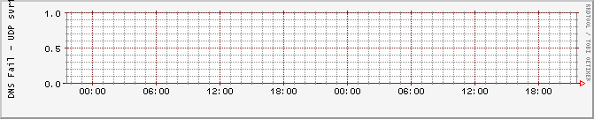
What is DNS?
Domain Name System
Translates traditional URLs into IP addresses
Ex: www.illinois.edu -> 128.174.4.87
Ubiquitous and long-standing: Average user not aware of its existence
Desired Performance, as observed PlanetLab nodes at Rice and University of Utah

Slide 6
Environment and Workload
PlanetLab
Internet scale test-bed
Very large scale
Geographically distributed
CoDeeN
Latency-sensitive content delivery network (CDN)
Uses a network of caching Web proxy servers
Complex distribution of node accesses + external accesses
Built on top of PlanetLab
Widely used (4 million plus accesses/day)

Slide 7
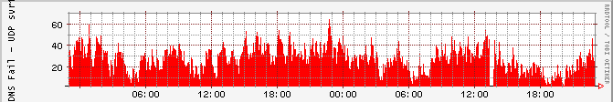
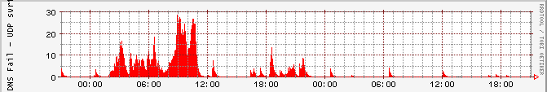
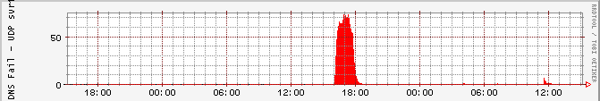
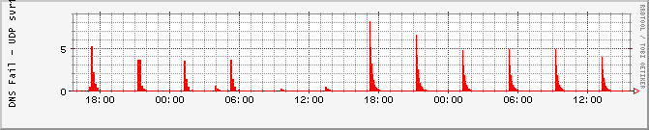
Observed Performance
Cornell
University of Oregon
University of Michigan
University of Tennessee

Slide 8
What is not working?
DNS lookups are high reliability, but failures are still responsible for significant delays.
Reliability due to redundancy, which drives up latency
Failures significantly skew average lookup times
Failures defined as:
5+ second latency – the length of time where the system will contact a secondary local nameserver
No answer
Is this a reasonable metric for failure?

Slide 9
Time Spent on DNS lookups
Three classifications of lookup times:
Low: <10ms
Regular: 10ms to 100ms
High: >100ms
71%-99.2% of time is spent on high latency lookups, despite accounting for 0.5% to 12.9% of accesses
Time spent on failure dominates overall lookup time

Slide 10
Failure Classification
Long lasting, continuous failures:
- Result from nameserver failures and extended overloading
Cornell
Short sporadic failures:
- Result from temporary overloading
University of Oregon
Periodic Failures – caused by cron jobs and other scheduled tasks
University of Michigan
University of Tennessee

Slide 11
CoDNS Ideas
Attempt to resolve locally, then request data from peers if too slow
Distribute DNS cache across many peers - Improve size and performance of “global cache”
Design questions:
How important is locality ?
How soon should you attempt to contact a peer?
How many peers to contact?

Slide 12
CoDNS Counter-thoughts
This seems unnecessarily complex – why not just go to another local or root nameserver?
Many failures are overload related, more aggressive contact of nameservers would just aggravate the problem
Is this worth the increased load on peer’s DNS servers and the bandwidth of duplicating requests?
Failure times were not consistent between peers, so this likely will have minimal negative effect

Slide 13
CoDNS Implementation
Stand-alone daemon on each node
UDP for queries, TCP for local name lookups
Master & slave processes for resolution
Master reissues requests if slaves are too slow
Doubles delay after first retry
Dynamic reissue delay

Slide 14
Results
Overall, average responses improved between between 16% and 75%
Host lookups: 37ms to 7ms
Real Traffic: 237ms to 84ms
At Cornell, the worst performing node, average response times massively reduced:
Host lookups: 554ms to 21ms
Real Traffic: 1095ms to 79ms

Slide 15
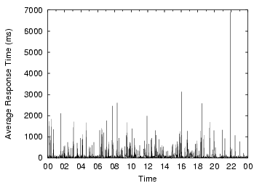
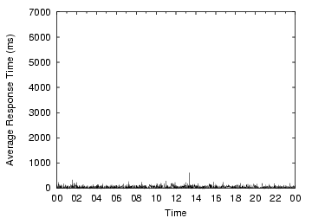
Results: One Day of Traffic
Local DNS
CoDNS

Slide 16
Observations
Three observed cases where CoDNS doesn’t provide benefit:
Name does not exist
Local nameserver poorly gathers neighbors
Network prevents CoDNS from contacting peers
CoDNS uses peers for 18.9% of lookups
34.6% of remote queries return faster than local lookup.

Slide 17
Overhead
Extra DNS lookups:
Controllable via variable initial delay time
Naive 500ms delay adds about 10% overhead
Dynamic delay adds only 18.9%
Extra Network Traffic:
Remote queries and heartbeats only account for about 520MB/day across all nodes
Only 0.3% overhead for CoDeeN workload

Slide 18
Questions
The authors took a black box approach towards observing and working with the DNS servers, do you think a more integrated method could further improve observations or results?
CoDNS proved to work remarkably well in the PlanetLab environment, would it behave comparably in a home environment?
If not, where else could the architecture prove useful?

Slide 19
Questions (continued)
It seems a surprising number of failures result from Cron jobs, should this have been a task for policy or policy enforcement?
Are there any other tasks where failures dominate usage, and could benefit from knowledge gained by CoDNS?

